Slide 1


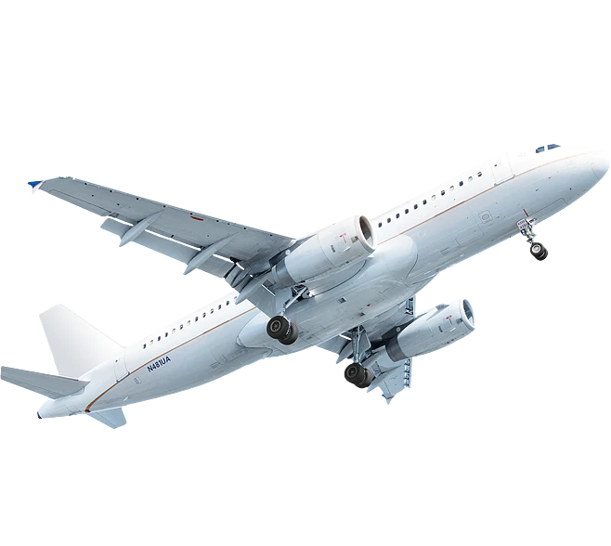





Deconstruct Complexity. Rebuild Order
GLOBAL RESOURCES · INTEGRATED SOLUTIONS
TO-U GLOBAL

Slide 2



CLIENT PAIN POINTS
Complex Demands: Why Is Delivery Getting Harder?
When resources come from different countries and suppliers, complexity multiplies
Too Many Suppliers
Fragmented Sourcing
Complex Cross-Border
Procurement
Too Many Contacts
Each product category requires a new round of supplier screening.
Furniture, materials, and soft furnishings come from different sources.
Language, time zones,
settlement, and compliance
all add layers of complexity.
Dozens of contacts per project
Information
Asymmetry
Varying Standards
Complex Logistics
Heavy Coordination
Price and quality are difficult to verify independently.
Different factories follow different standards.
Multiple batches, destinations, and schedules.
You become the coordination hub for every stage.
The real challenge is not finding a product — it's organizing all the resources.

Slide 3






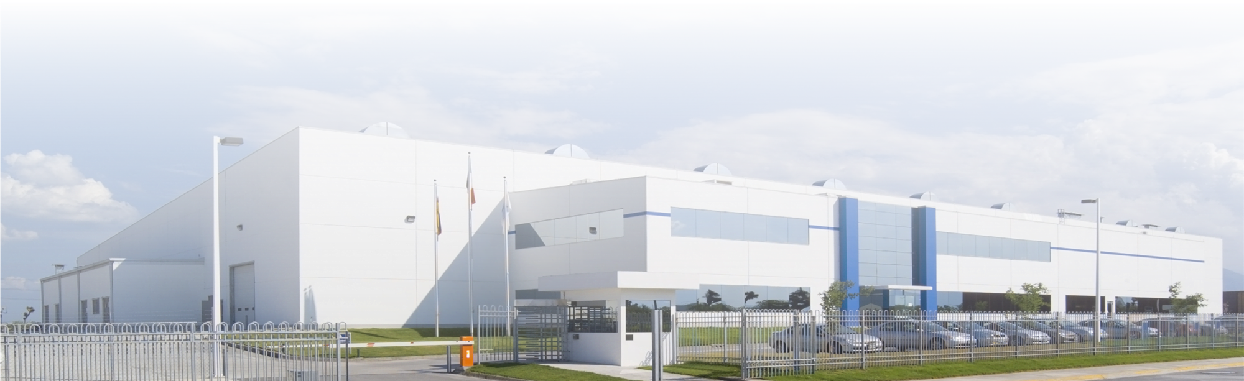
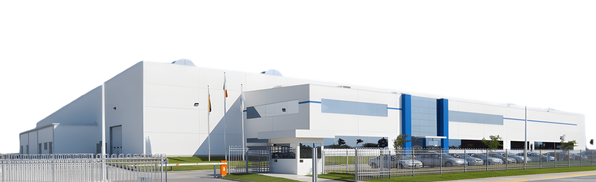
WHO WE ARE
TO-U
Manufacturers
Brands & Products
Industry Resources
Local Partners
Technology
Logistics
GLOBAL
TO-U Global is a global supply chain integrator and delivery service provider. We connect manufacturers, brands, technology providers, logistics providers, and local service partners across China and global markets, delivering end-to-end solutions—from resource matching and procurement to production, quality control, and cross-border delivery.

Slide 4


GLOBAL RESOURCE NETWORK
The Network Between Demand and Delivery
Client Demand
Manufacturers
Brands & Products
教学
模式
Connect &
Integrate
Technology
Logistics
Local Partners
Industry Resources
Clients bring complex demands. TO-U connects global resources, integrates them into executable solutions, and drives delivery.
Demand
TO-U GLOBAL
Global
Network
Connect & Integrate
Solutions
Delivery

Slide 5


FROM RESOURCES TO SOLUTIONS
How Resources Become Solutions
Resources
Connect
Integrate
Solutions
Deliver
Value
Manufacturers · Brands
Products · Technology
Logistics · Local Partners
Match resources
to client demand
Integrate products,
supply chain, logistics,
and service capabilities.
Executable solutions
for specific needs
Coordinate production,
QC, logistics, installation,
and local services.
Four measurable
outcomes below
The Value TO-U Creates for Clients
Reduced Communication Complexity
Higher Sourcing Efficiency
Optimized Supply Chain
Greater Project Certainty
What clients really need is not more suppliers, but one solution that organizes the resources.

Slide 6




WHAT WE SOLVE
What Can We Solve for You?
Not by product category — by your problems
01
02
03
Find
Procure
Optimize
04
05
06
Integrate
Develop
Deliver

Slide 7
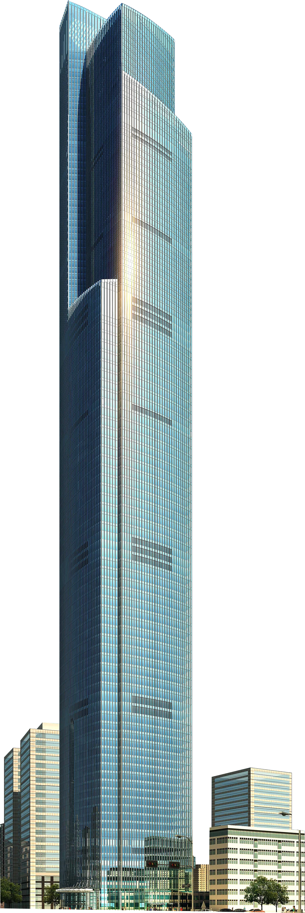


CORE CAPABILITIES
Global Resource Connections
Connecting global manufacturers, brands, products, and industry resources.
Integration
Four Capabilities That Define How We Work
Combining scattered resources into executable solutions.
Cross-Industry Connectivity
Enabling specialized resources to cross industry and geographic boundaries.
Global Delivery
Driving supply chain, logistics, and local services
through to implementation.

Slide 8








INTERIOR & BUILDING
INTERIOR & BUILDING
Furniture
Materials
Hardware
Doors & Windows
Equipment
Lighting
Sanitary Ware
Security
Full-Chain Resource Integration
Interior & Building — A Proven Use Case — not the whole of our scope.
Design
Sourcing
Production
QC
Logistics
Installation

Slide 9
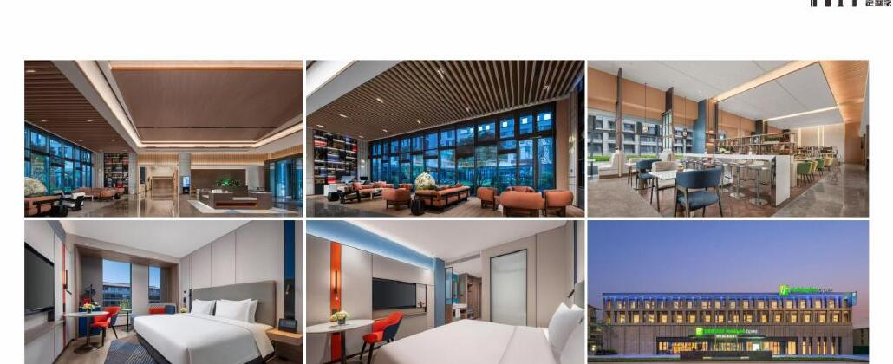
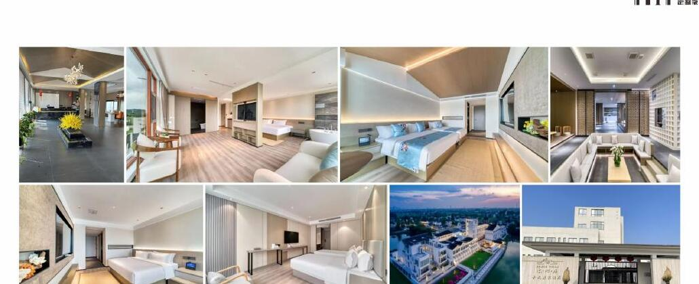
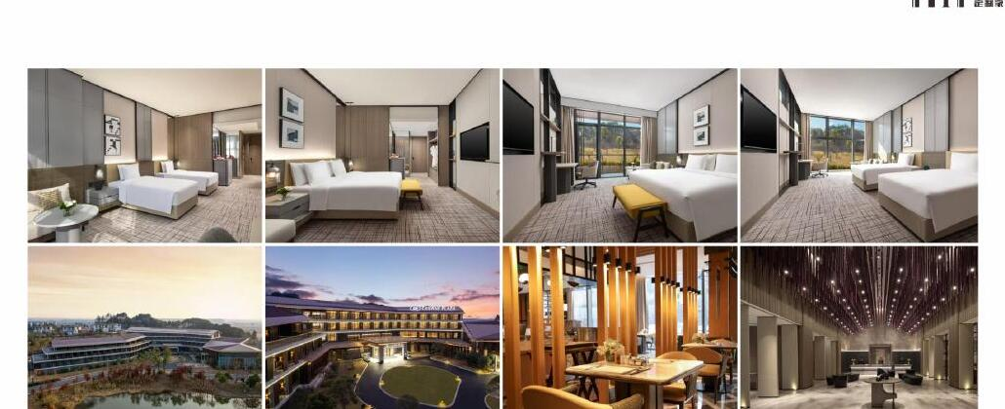
PROVEN SCENARIOS
Proven Delivery Scenarios
Three types of delivered projects within TO-U's interior & building resource system.
Tier-1 City CBD Hotel
Resort Boutique Hotel
Regional Hub
Star-Rated Hotel
Complete FF&E Package
Full-Chain Delivery
Standardized
Coordinated Delivery

Slide 10
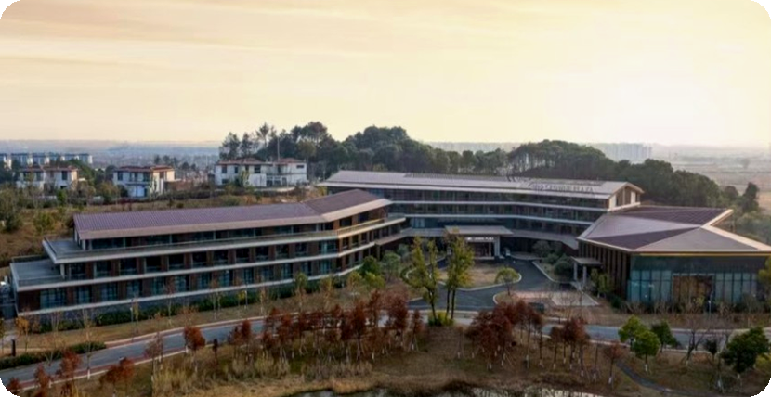
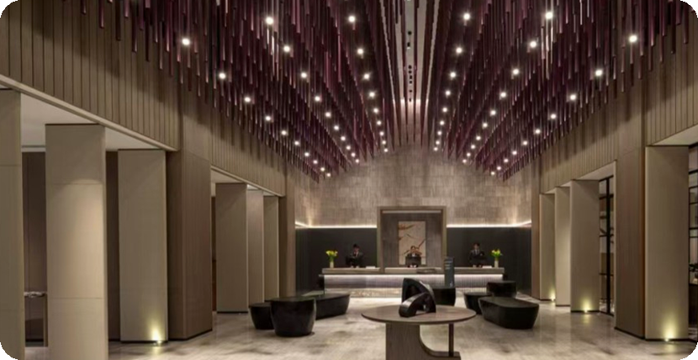
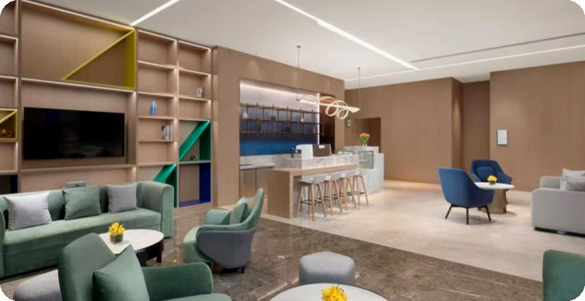
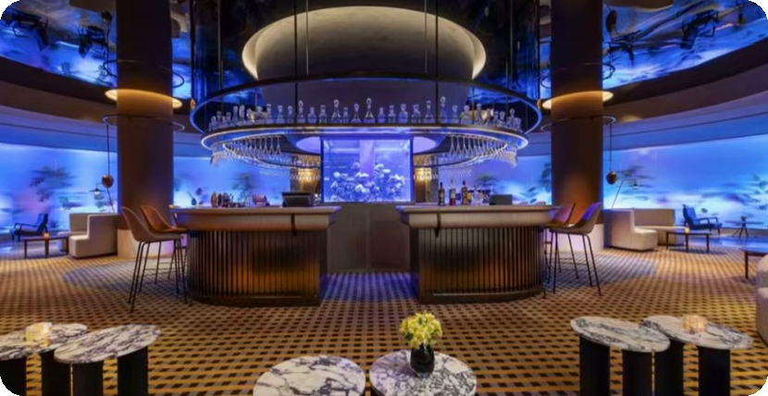
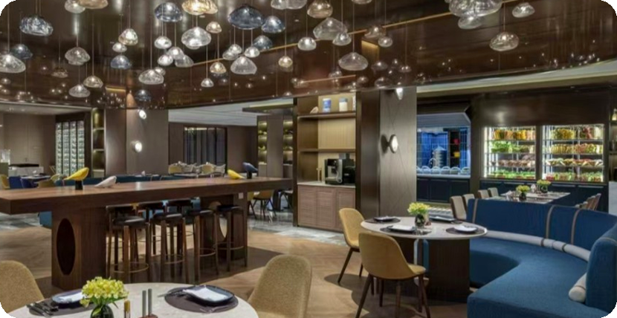
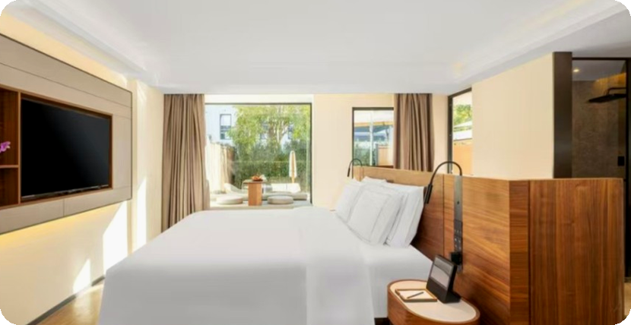
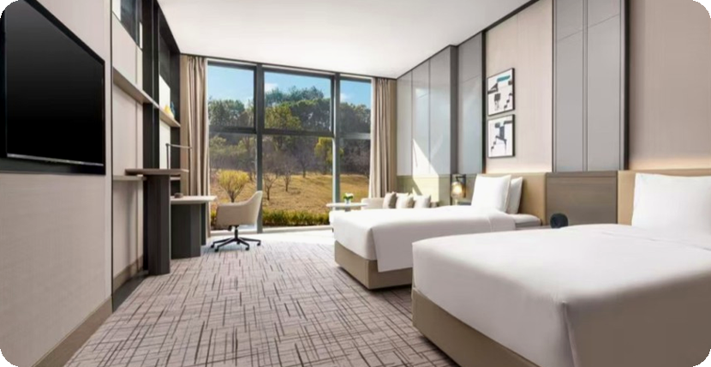
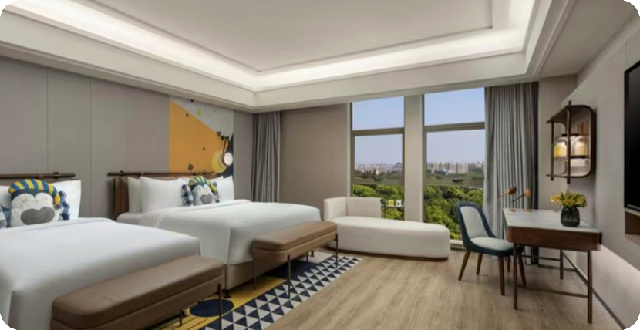
PROJECT CASE
Featured Case: Hotel Custom Furniture
Lobby Reading
Lounge
Project Overview
Lobby Area
Bar
All-Day Dining
King Room
Twin Room
Family Room
Type
Scope
TO-U Role
Hotel / Hospitality
Custom Furniture / FF&E
Requirements Alignment ·
Resource Integration · QC ·
Delivery Coordination

Slide 11
GLOBAL SUPPLY CHAIN
How Resources Actually Reach Global Delivery
Design
Procurement
Production
Quality Control
Int'l Logistics
Customs
Clearance &
Compliance
Local Delivery
Time-Zone Coordination
CN/EN Bilingual Team
Export & Destination Compliance
Flexible Logistics
Multi-Currency Settlement
Local Partners
Global resources. Local delivery.

Slide 12
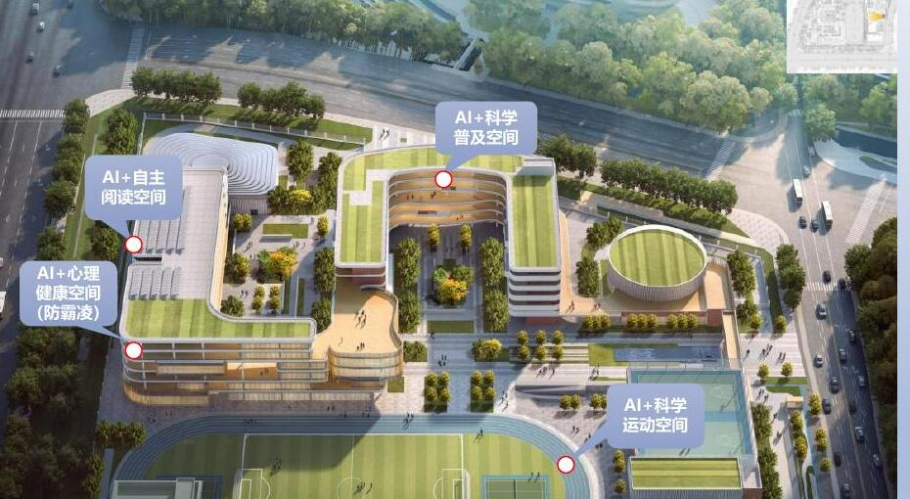
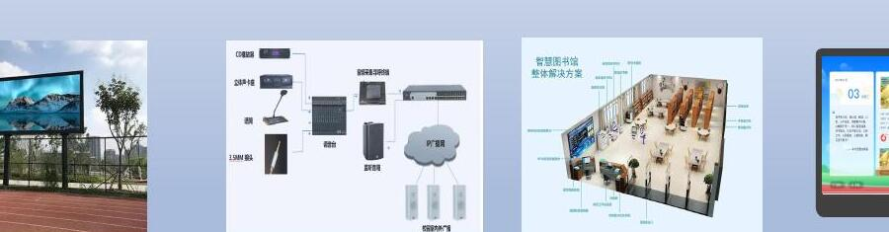
INDUSTRY EXTENSION
From Proven Capability to More Industries
Extension Directions
Automotive
New Energy
Healthcare
Smart Technology
AI+ Smart Campus
We connect industry resources based on client needs, without overstating the maturity of our capabilities in any sector.
Including AI+ smart classrooms, smart library, and smart sports spaces.

Slide 13
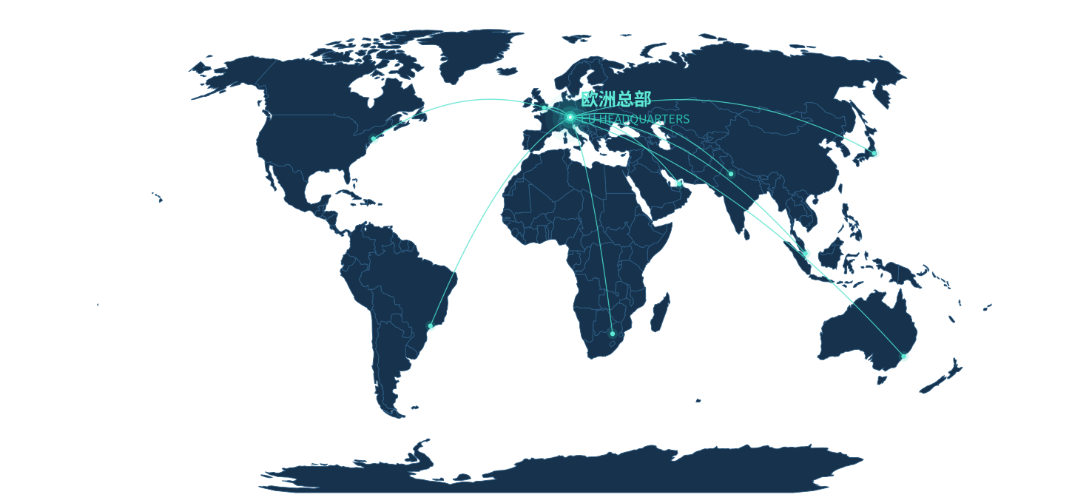
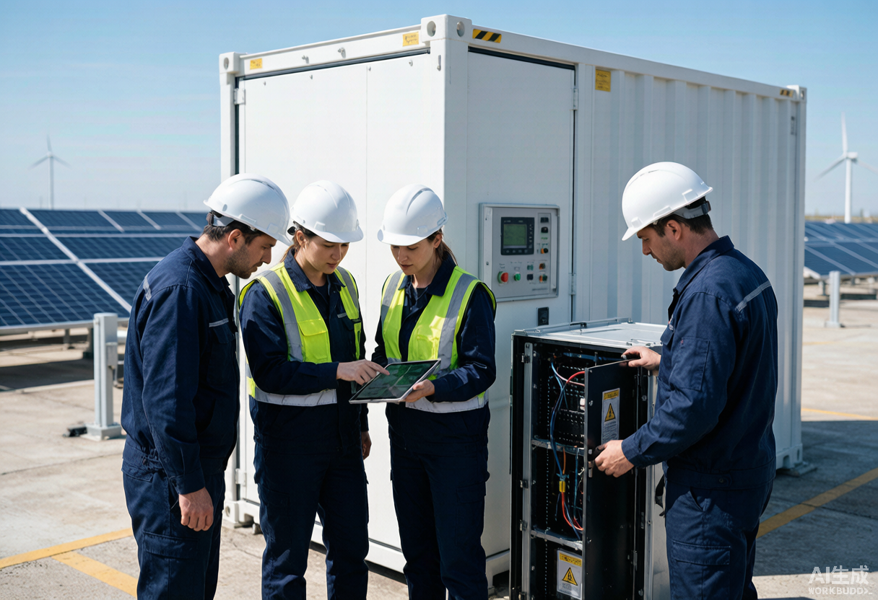
OVERSEAS OPERATIONS
From Remote Links to Local Roots
European Headquarters
as a Strategic Hub
Anchored by our European HQ, radiating into key global markets — seamless across time zones and cultures.
Locally Rooted Teams
GLOBAL NETWORK
Senior experts stationed on-site plus local talent — fluent in language, business rules, regulations and supply networks.
Face-to-Face Engagement
Breaking through screen and time-zone barriers, we work on-site with clients and at overseas factories to capture needs accurately and advance negotiations and quality control efficiently.
Overseas Team · On-site Survey & QC
A global network, delivering local results. Face-to-face gives cross-border collaboration far greater certainty.

Slide 14


Green Energy Matrix
Core Energy Products · Intelligent Control · System Solutions
Power Electronics
& Energy Conversion
Battery
& Energy Storage
Battery Management
& Energy Control
Smart Energy
Solutions
Energy Storage Power Conversion Systems (PCS)
PV Inverters
Solid-State Transformers (SST)
DC/DC Converters & Power Conversion Equipment
Energy Storage Batteries
Power Batteries
Sodium-Ion Batteries
Solid-State / Semi-Solid-State Batteries
High-Power Automotive Start-Stop Batteries
Battery Management Systems (BMS)
Distributed BMS
Energy Management Systems (EMS)
Battery Sensing & Monitoring Systems
Battery String/Cluster Management System (BSU)
Commercial & Industrial Energy Storage
PV + Energy Storage Solutions
AC/DC-Coupled Microgrids
800V DC Power Solutions for Data Centers & AI Computing
Power Solutions for New Energy Vehicles
Beyond individual product supply, we integrate global resources to connect core products, technologies and system solutions, delivering practical smart energy solutions for diverse applications.

Slide 15

TECHNOLOGY EXTENSIONS
Technology Extension: Into High-Tech & Premium Manufacturing
Intelligent Robots & Drones
Advanced Medical Devices
Smart Technology & Special Equipment
New-energy power and smart automotive parts fused with robots and drones — providing supply-chain support for power and sensing systems.
Power-electronics precision and high-reliability standards applied to medical devices — expanding life-science resources.
Core energy technology extended into the low-altitude economy and frontier fields through supply-chain integration.
TO-U connects not just products, but the industrial forces that define the future.

Slide 16
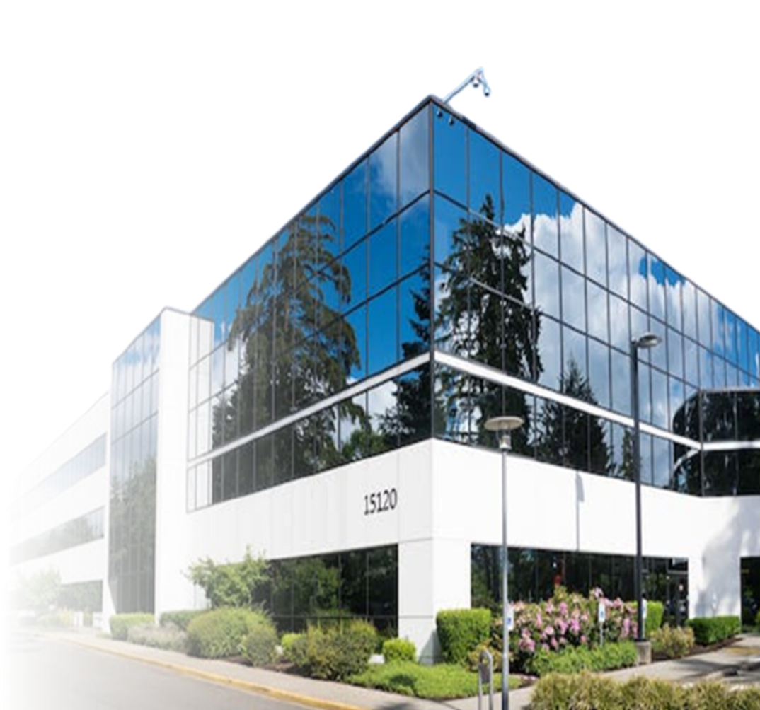
CLOSED LOOP
Global Delivery: A Closed Loop from Integration to Delivery
Interior fit-out, new-energy power or frontier tech — TO-U lands every complex requirement precisely, locally.
Solution Integration
Global Sourcing
Local Delivery
Tailored to every client's needs — Products, Supply Chain, Logistics & Services integrated into one executable cross-border plan.
A global resource network matching optimal manufacturing resources — handling multi-currency settlement and cross-border procurement compliance.
Backed by our European HQ and overseas teams — handling customs clearance and destination compliance, driving on-site installation, commissioning and final delivery face-to-face.
Every cross-border project finds its most reliable local execution point.
Not limited to a single industry — turning global resources into deliverable, verifiable results.

Slide 17


WHY TO-U
Our strength is not what we sell, but what we can connect
02
03
01
04
Simpler Cross-Border Communication
More Flexible Resource Options
Reduced Supplier
Management
Complexity
More Complete Project Coordination
Bilingual team across time zones — shorter communication paths.
A continuously growing network matching broader needs.
From supply chain to local services, driving solutions through to implementation.
One project team interfaces with multiple vendors, reducing your management load.
Our strength is not what we sell — it's what we can connect.

Slide 18

HOW TO START
Start with One Small Need, Build a Long-Term Partnership
01
02
03
04
Understand
Needs
Match Global
Resources
Solution
Integration
Trial Order ·
Project Validation
Start with one need — and grow into a long-term partnership.

Slide 19

See Beyond Through Connection.
Contact: Mr. Zhong
SEE BEYOND THROUGH CONNECTION.
+86 139 6729 0907
conradchung@to-uglobal.com
No. 198 Jiaogong Road, Xihu District, Hangzhou, Zhejiang, China
TO-U Global (Hangzhou) Co., Ltd.
Our strength is not what we sell — it's what we can connect.

